Slide 1


Mediation Activity:
Expressing a personal response to a creative text
Touchscreen

Slide 2
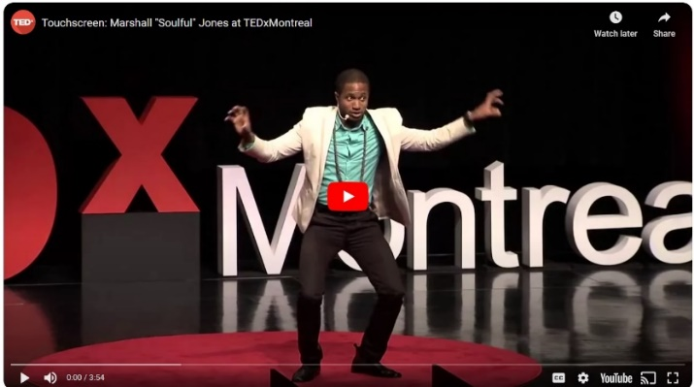

Slide 3
In this lesson you’re going to …
Mediate texts about slam poetry
Brainstorm the pros and cons of smart phones
Watch a video of Touchscreen and discuss it

Slide 4



Mediating a text
Can you successfully mediate the content of a written text? Yes / No
Language
Mediation
She can understand
the text.
He can’t understand the text without her. She helps him understand. It is an interactive process
She can help him by ….
Mediation is interactive
He can help her to help him by ….

Slide 5

Task 1: Reading, note-taking, mediating
Work in groups of 3. Assign each member a letter: A, B, C. Each of you has a different text to mediate
  Student A: What is slam poetry?
  Student B: What’s a poetry slam?
  Student C: What’s the difference between slam poetry and rap?
- Use the handout to make notes in answer to your question.
- Mediate your text, i.e. tell your group about your question.
You can use your notes, but not the handout.
- Actively listen to the other members of your group, i.e. ask questions and make notes, as they tell you about their question.
Against the clock

Slide 6
How well did you do?
How well did you mediate your text?
How many pieces of info did you note down? How many did your team-mates note down?
What were they?

Slide 7
Smart phones
What do you think of when you think of smart phones?
Working in your group, brainstorm how many positive and how many negative aspects can you think of?
Positive | Negative

Slide 8


Touchscreen
Watch the video.
What is Touchscreen about?

Slide 9
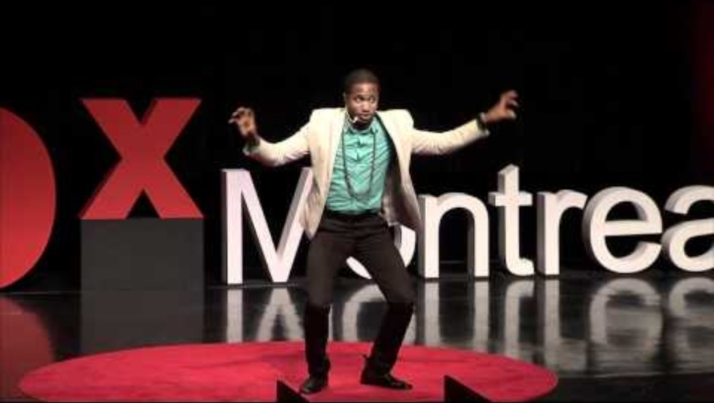

Slide 10
Expressing a
personal response
to a poem

Slide 11
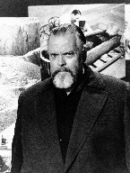


Touchscreen and poetry slams
I don't know anything about poetry, but I know what I like
(with apologies to Orson Welles).
How much did you enjoy Touchscreen?
Do you think that Marc Kelly Smith did have a good idea? Does slam poetry, and do poetry slams, help bring poetry back to life? If so, how?
 | 10 | 9 | 8 | 7 | 6 | 5 | 4 | 3 | 2 | 1

Slide 12
Mediating Activity: expressing a personal response
Can you give a clear presentation of your reactions to a poem, develop your ideas and support them with examples? Yes / No
Can you describe your emotional response to a poem and elaborate on the way in which it has evoked this response? Yes / No

Slide 13
What did you think of Touchscreen?
Work as a team.
Prepare and perform a review of Touchscreen
    Outline your review
    Synopsis
    Performance & delivery
    Theme &/or message
    Language
    Personal response
  Use your outline to prepare a presentation – to be judged using poetry slam rules
  Present your review

Slide 14
Analysis & Reflections
Working within your team, share your thinking about the task.
can you give a clear presentation of reactions to a poem, develop ideas and support them with examples?
How interesting or otherwise was it for you?
How enjoyable or otherwise was it?
How easy or difficult was it for you?
What did you learn …
… about slam poetry?
… about expressing a response to a poem?
… about word play?
Would you like to watch other slam poems?
Notes:
Teacher Access the form here

Slide 15
Other slam poems

Slide 16
Reviewing & expressing a personal response to other slam poems
the type
when a boy tells you he loves you
lost voices.
the drug dealer’s daughter
mama
hair
what kind of asian are you
adrenaline rush
Choose one of the slam poems on offer
Watch the video
Write a review
Prepare your performance
Give your performance
Judging
Analysis & Reflections

